Slide 1
D2L Biannual Release
Midyear 2025

Slide 2
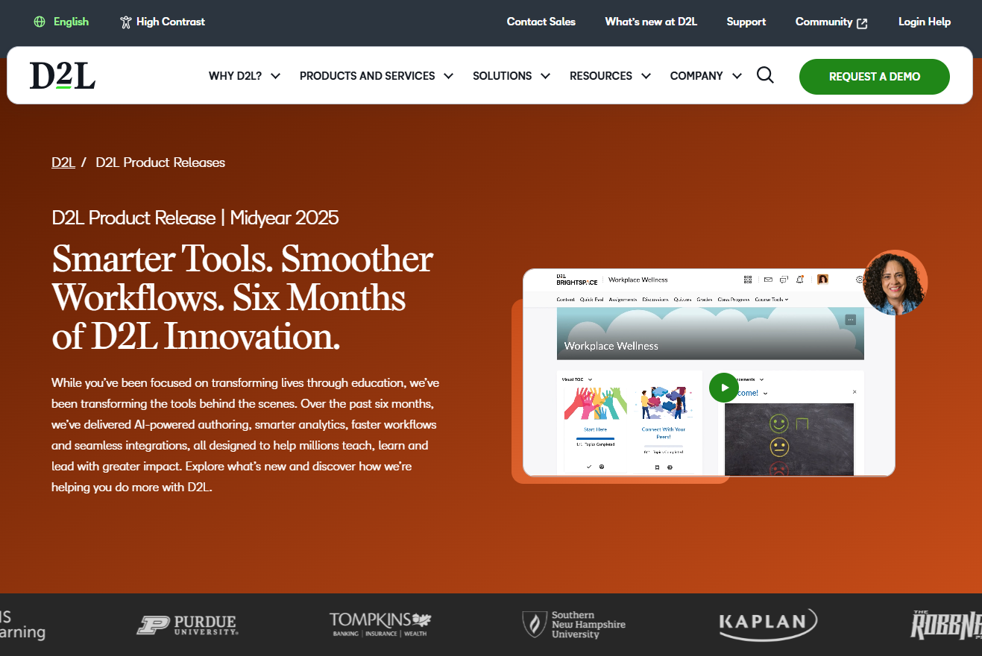
D2L Biannual Release
Your input powers what’s next at D2L. Our biannual releases spotlight the latest features and enhancements — January to June in the mid-year drop, and July to December in the year-end wrap-up — so you’re always in the loop and ready to take learning further!
This deck is designed to be a resource you can share across your organization to keep stakeholders informed and support adoption of new tools and features.
Want to see more? View our:
Monthly Release Notes for detailed feature updates
Brightspace Community for documentation, conversations, free courses and product idea exchange
Product roadmap that is updated every six months (Feb and Aug) for longer-range planning
Visit our public biannual release webpage here

Slide 3

What’s Included
Feature Name
Feature description
Jobs to be done
Use Case
This is where we identify how the feature is adding value.
Where is this feature available?
Which Package?
Live, LA, Beta?
You’ll see the month and feature name listed in each note, making it easy to match with the full release notes.
Availability:
Package,
Beta,
Global

Slide 4




One Platform for All Your Needs
D2L Brightspace
D2L Creator+
D2L Performance+
D2L Lumi
Course Merchant
D2L Link

Slide 5

Brightspace
Transform the Learning Experience

Slide 6
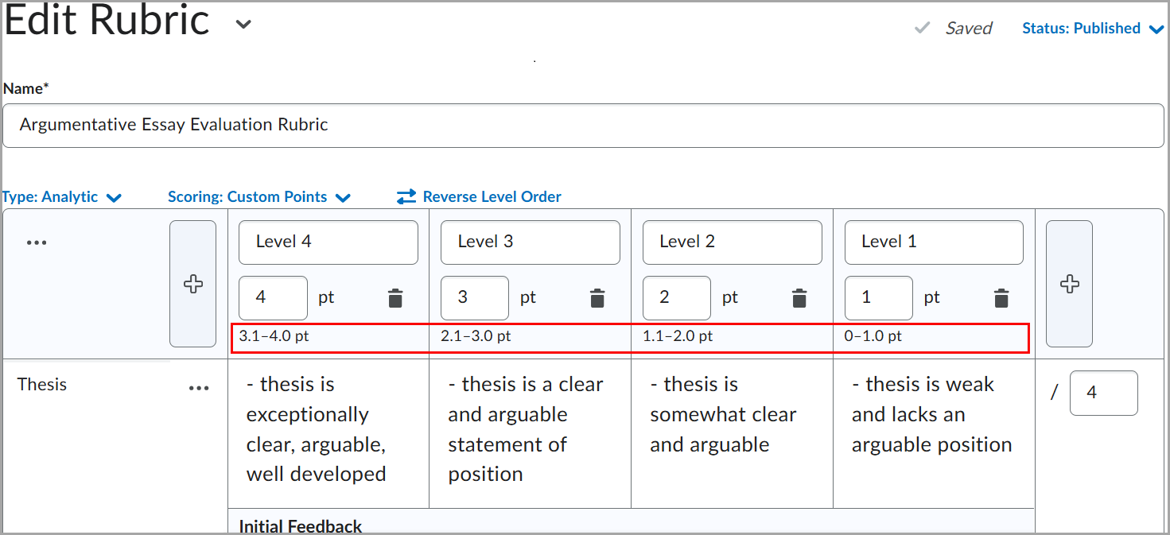
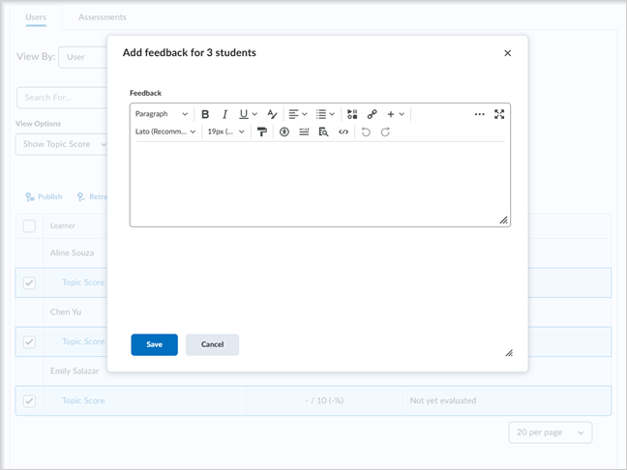
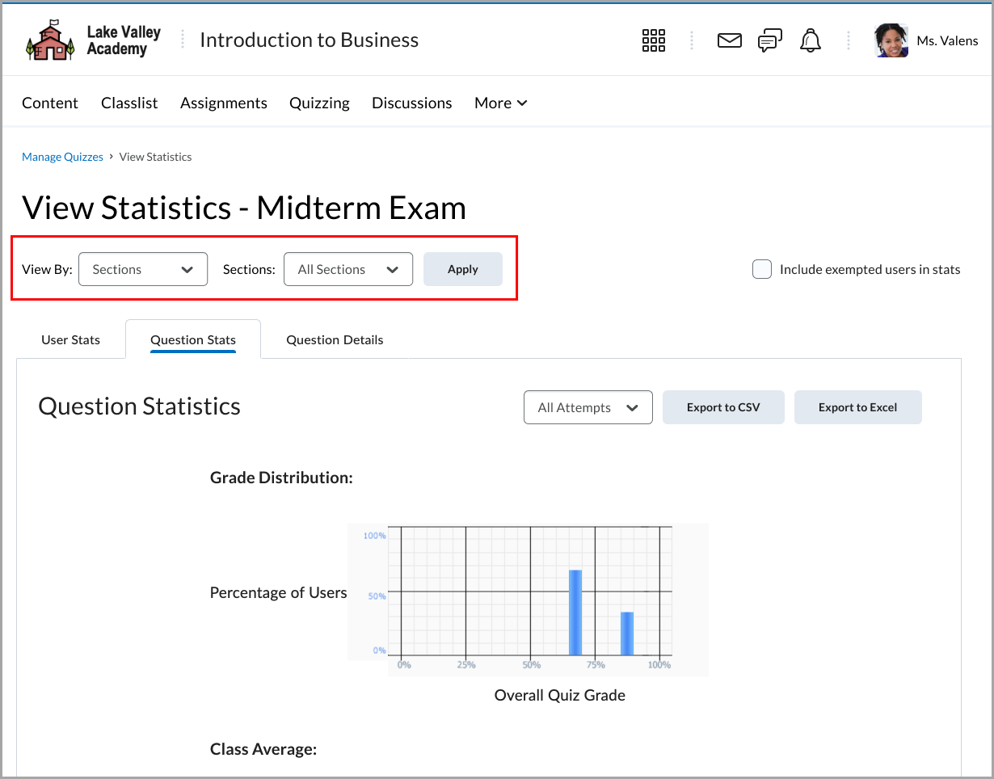
Assessment
Grading is now faster and more flexible with new tools across Assignments, Discussions, Quizzes, and Rubrics:
Bulk feedback in Assignments and Discussions lets you give feedback to multiple learners at once
Quiz evaluation now supports all Brightspace question types with group or section specific filters
Rubric ranges make grading criteria clearer for both instructors and learners
Assignment and Discussions evaluations are synchronized with the Gradebook
Use Case
Instructors can streamline assessment workflows across all class sizes. Easily provide group feedback in Assignments and Discussions, zero in on quiz performance with group-specific filters and evaluate any quiz question type with confidence.
Rubric range displays reduce confusion and help learners better understand how they’re graded—supporting a fairer, more transparent assessment process.
Synchronization ensures evaluations and grading stay accurate and consistent without extra steps.
Rubric ranges, bulk feedback and quiz filters
Availability: Brightspace, Live, Global
Notes:
Consistent Evaluation – Assignment and Discussion evaluations now synchronized with Grade Book – Jan 2025
Rubrics – Streamline grading with minimum or maximum score for ungraded rubric criteria – Jan 2025
Quizzes – Filter Quiz Statistics by Section or Group - Feb 2025
Rubrics – Added Rubric Level Range Visual - March 2025
Quizzes – Additional question types in new quiz evaluation experience - March 2025
Assignments and Discussions – Bulk feedback for instructors – April 2025
Assignments – Retract feedback in bulk on the Submissions page – May 2025

Slide 7
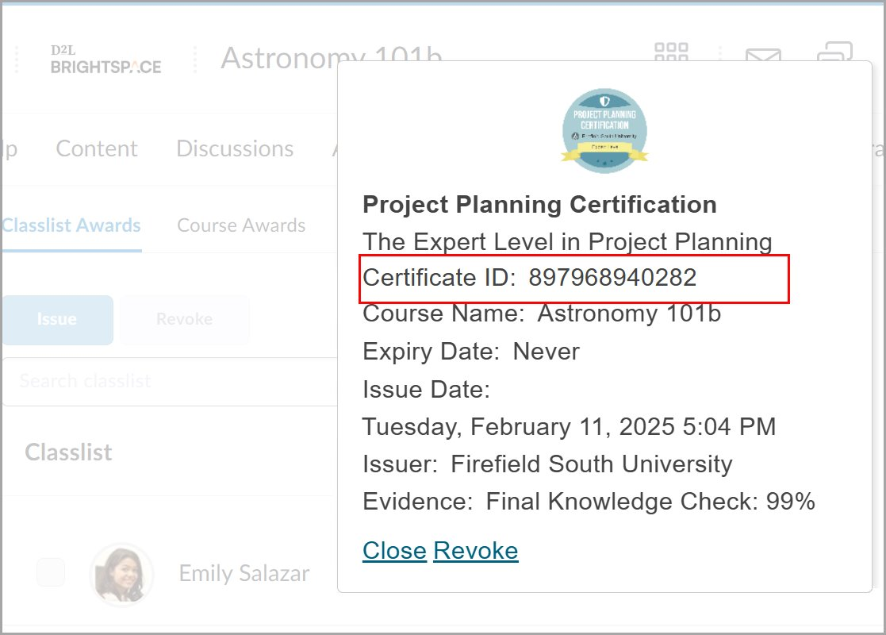
Awards
Easily manage and share learner achievements with new awards enhancements in Brightspace.
Set or backdate the issue date when manually granting awards
Add a unique Certificate ID for each award
Control whether Certificate IDs appear on public pages, LinkedIn or digital credentials
Use replacement strings to personalize certificates and templates at scale
Use Case
Administrators and instructors can now issue awards with greater flexibility.
Whether recognizing past achievements or customizing how awards appear when shared, these updates give organizations more control over recognition when learners are showcasing accomplishments.
Unique Certificate ID for each award
Availability: Brightspace, Live, Global
Notes:
Awards – Option to enter Issue Date when manually issuing awards - March 2025
Awards – Control the Certificate ID parameter for shared awards - March 2025
Awards – Replacement strings for award issuer on certificates – June 2025

Slide 8
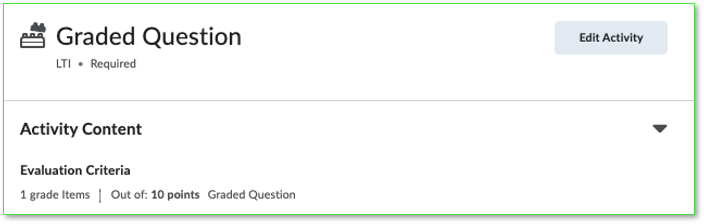
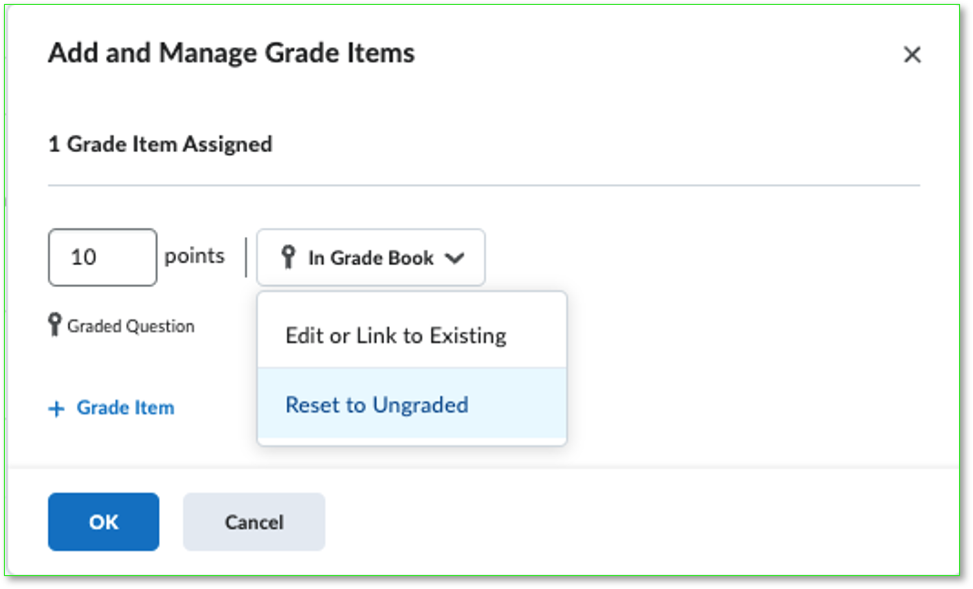
Integrations
Brightspace gives you more control and visibility when using LTI tools:
Set up grading for new external learning tools directly from the LTI link editor
Change or reset an existing LTI grade association, easily and safely, in the same editor screen
Track LTI link usage with new data, including link placement date, deployment ID and content type
Use Case
Instructors can manage external tool grades with more precision—keeping the gradebook clean and aligned with course needs.
Administrators gain deeper insights into how LTI tools are deployed and used across courses, improving oversight and reporting.
Manage grade items screen
Availability: Brightspace, Live, Global
Notes:
LTI – Remove grade associations from graded LTI content topics – Feb 2025

Slide 9
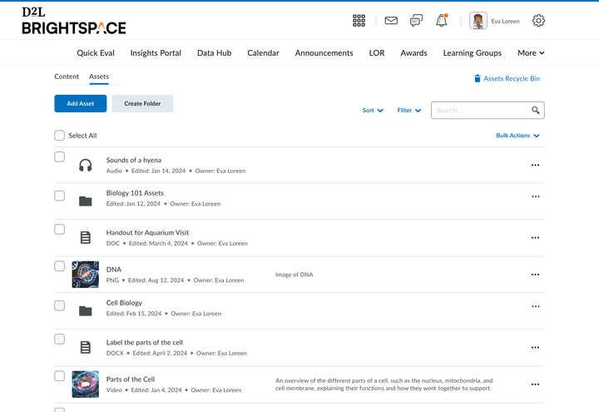
Media Library Update
A fresh new look for Media Library that allows for storing, updating and reusing all files, not just video and audio.
Support for more file types, including SCORM objects, Office documents, images and PDF files. Add content in the Media Library and seamlessly import it into course structures.
Use Case
Improves workflow efficiencies, streamlines content management and enhances content reusability for Educators and Creators.
The new Media Library experience
Availability: Brightspace, Live, Global
Notes:
Media Library – New User Interface for Media Library – April 2025

Slide 10
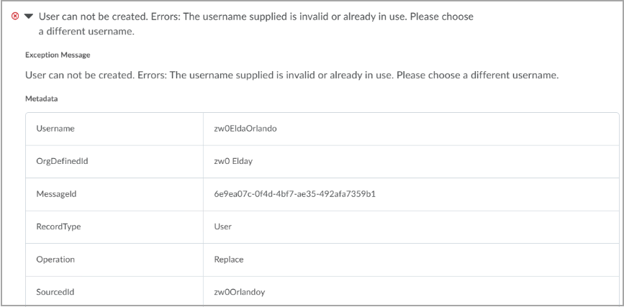
IPSIS
Brightspace improves SIS integration efficiency with the following features:
Faster Syncs: Detects and syncs only changes since the last update. Available to all clients using OneRoster REST.
Data Retention Control: Choose what data remains in Brightspace after a term ends, based on school policies. Available to clients using the GG4L OneRoster REST integration for PowerSchool SIS.
Error Detection: Flags duplicate or conflicting SIS data for quick issue resolution. Available to all clients using IPSIS, including OneRoster and D2L Standard CSV integrations.
Use Case
Admins integrating Brightspace with their SIS via OneRoster REST can keep enrollments up to date with greater speed and accuracy.
With term-end data controls and improved logging, it’s easier to manage records at scale, reduce sync errors, and support long-term data policies.
Review the enrollment error metadata to locate the duplicated user
Availability: Brightspace, Live, Global
Notes:
IPSIS –Prevent unenrollments and other deletions after semester end for GG4L and PowerSchool integrations - Feb 2025
IPSIS – Reduce time to synchronize enrollment differentials for OneRoster REST integrations - Feb 2025
IPSIS – Resolve duplicate user errors using additional log message context - Feb 2025

Slide 11
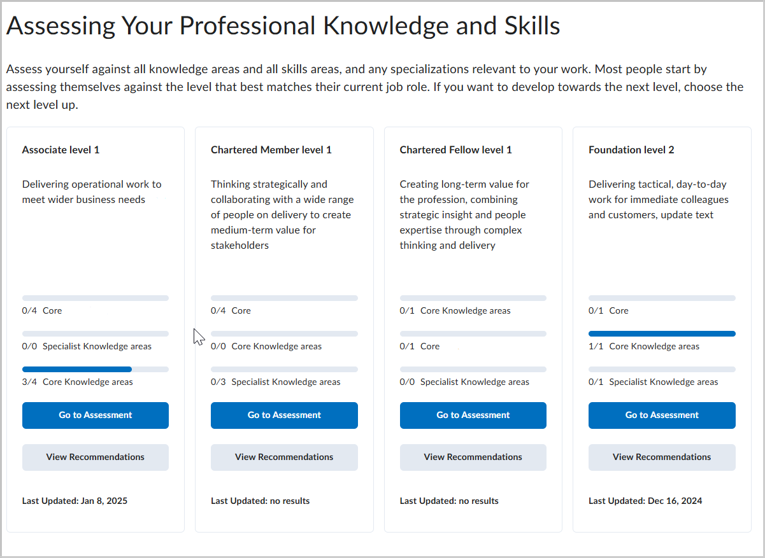
Profession Path
Empowers learners to take charge of their development through self-assessment, personalized recommendations, and learning plans — perfect for Associations and training-focused organizations using Brightspace.
Use Case
Profession Path empowers learners to build personalized growth plans and track progress over time.
Administrators can guide development with structured recommendations and gain valuable insights through engagement data and exports.
The Self Assessment page in Profession Path
Availability: Brightspace, Live, Global
Notes:
Profession Path – Discover learning opportunities for professional development – Feb 2025

Slide 12
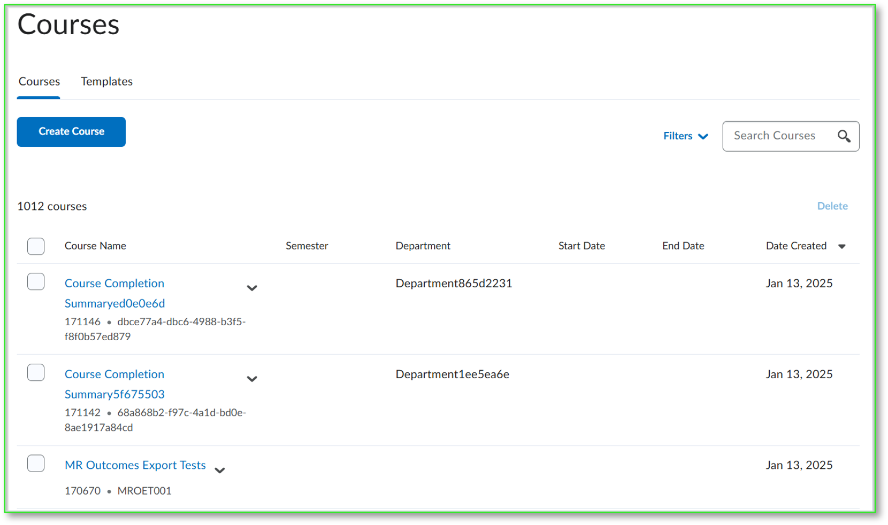
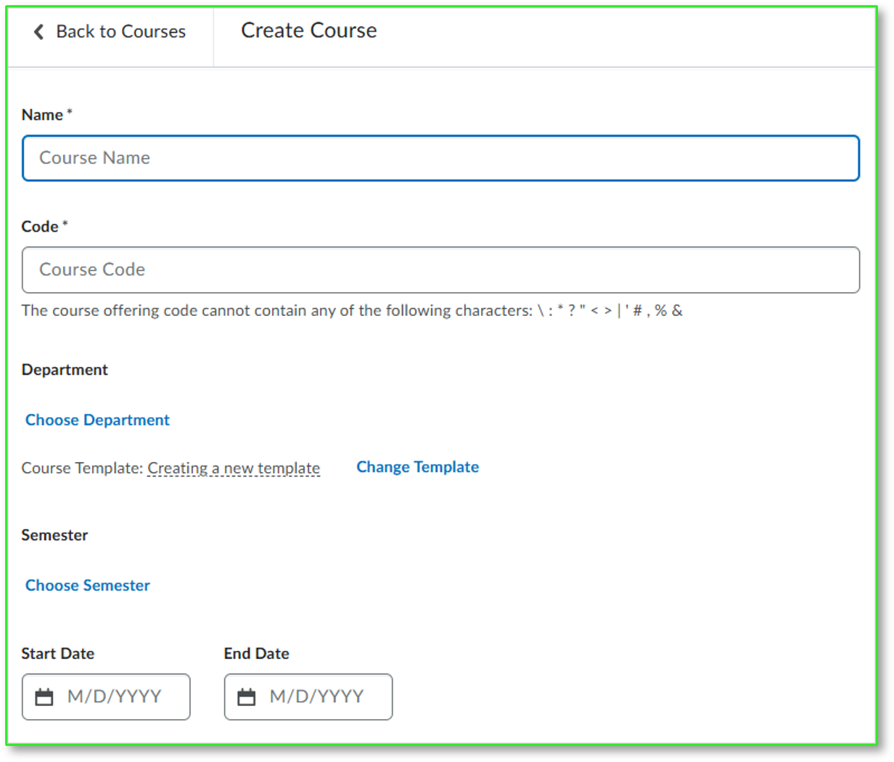
New Courses Tool
The new Courses tool simplifies course management for administrators. Create, copy and manage courses faster with a streamlined workflow.
Access course homepages, templates, and admin settings—all from one centralized location.
Use Case
Administrators can save time and reduce manual steps when managing courses at scale.
Whether setting up new terms, copying existing content, or editing course settings, the improved experience simplifies routine tasks and boosts overall efficiency.
New course management screenshot
Availability: Brightspace, Live, Global
Notes:
Course Management – Enhanced workflow and user experience in test environments – Feb 2025
Courses – New enhanced and accessible experience in production environments - June 2025

Slide 13
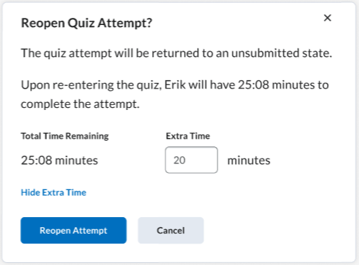
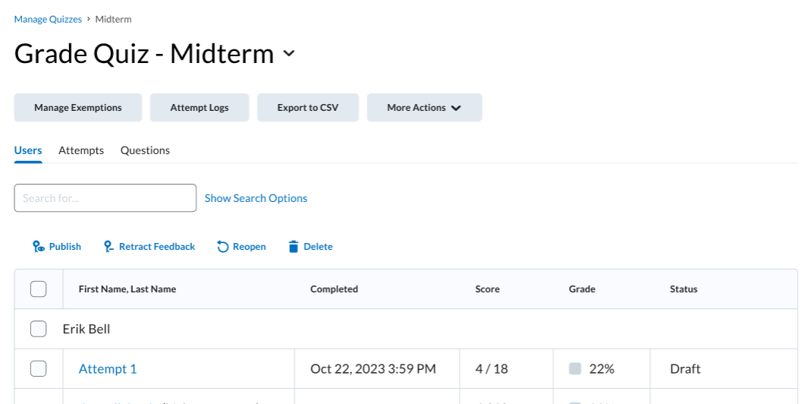
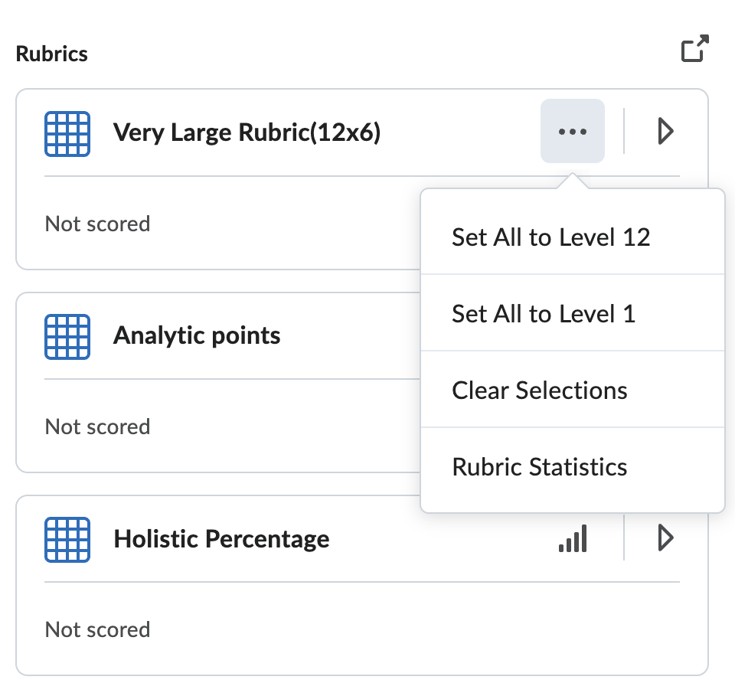
Feedback & Assessments
Make managing assessments more flexible:
Reopen quiz attempts so learners can pick up where they left off, even after the end date or time limit has passed
Instructors can now quickly remove all rubric level selections without affecting written feedback—ideal for fixing mistakes or starting over.
Quiz attempt screen
Use Case
If a learner needs more time on a quiz, it's easy to offer flexibility without starting from the beginning.
If an instructor accidentally applies the wrong rubric scores—especially during a bulk update—they can now reset the rubric scoring in just a few clicks. This saves time, reduces frustration, and keeps feedback intact.
It’s a simple but powerful way to support smoother, more flexible evaluation workflows.
Clear rubric screen
Availability: Brightspace, Live, Global
Notes:
Quizzes – Reopen a submitted quiz attempt – July 2025
Rubrics – Streamline grading with minimum or maximum score for ungraded rubric criteria – Jan 2025

Slide 14
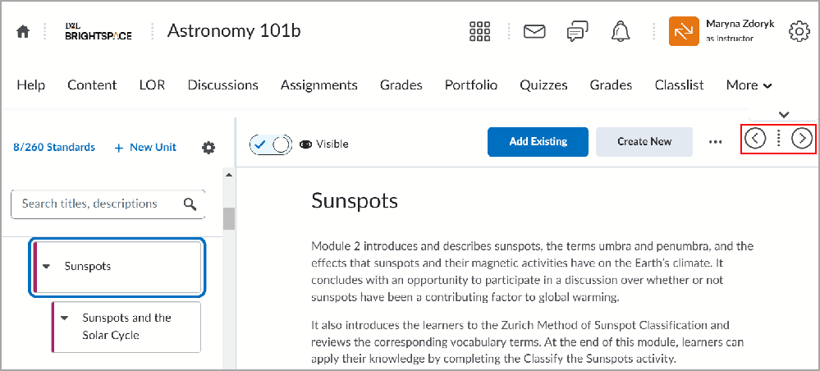
Navigate Course Content
Navigating course content is now faster and more intuitive in the New Content Experience:
New navigation buttons make it easy to move between topics in order
Drag-and-drop Modules supports up to five levels of nesting for better organization
Visibility controls let you decide how learners see upcoming or unavailable content
Use Case
Instructors can build and manage courses more efficiently, with improved control over how content is organized and accessed.
Learners benefit from smoother navigation and clearer progress tracking—making it easier to stay focused and on track.
Highlighting navigation buttons in the New Course Experience
Availability: Brightspace, Live, Global
Notes:
New Content Experience – Improved navigation between content topics – April 2025
New Content Experience – Add topic descriptions to provide context for activities – Feb 2025
New Content Experience – Module depth increased to support creating up to five nested levels – Jan 2025

Slide 15
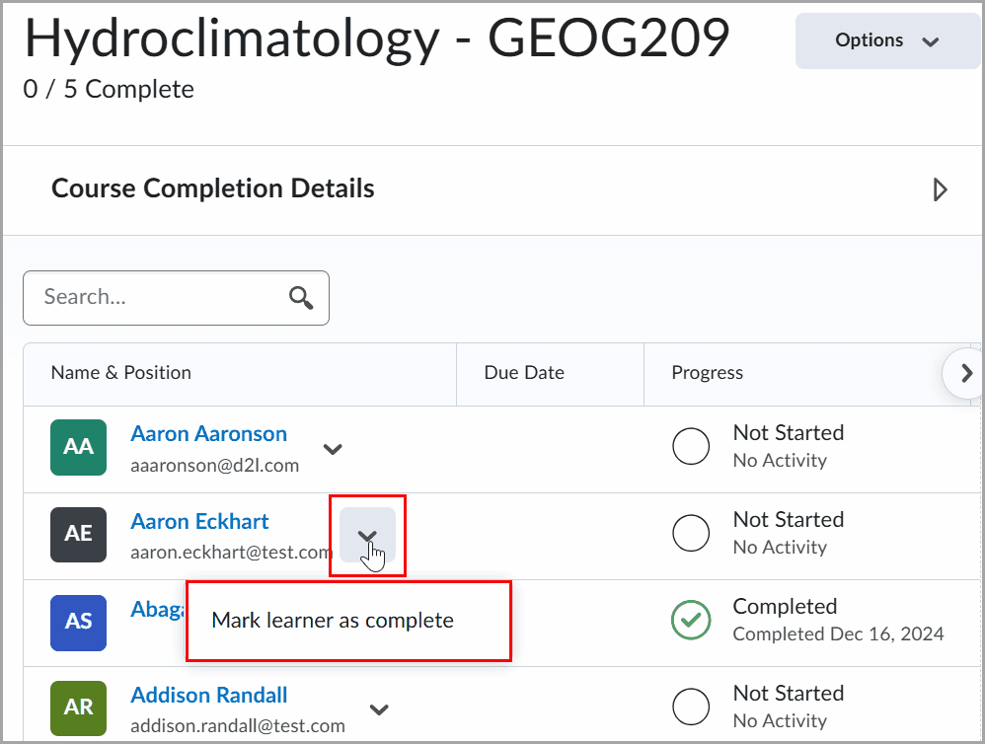
Course Completion Tracking
A new Outcome Achieved condition is now available in Course Completion Tracking. This condition allows a course to be marked complete only when a learner meets a specific learning outcome.
Administrators can also now manually override a learner’s completion status to mark it as complete or correct errors—providing flexibility for edge cases not handled by automated rules.
A new Course Completion release condition is now available, which is fulfilled when a learner completes the course. This condition enables automated interactions and workflows based on course completion status, providing instructors and administrators with enhanced automation capabilities.
Use Case
Instructors can align course completion with specific learning outcomes to support a more competency-based approach. This ensures learners don’t complete a course until they’ve demonstrated mastery, providing a clearer signal of progress and achievement for both instructors and learners.
Administrators gain greater control by manually updating completion statuses when needed, helping maintain accurate records and support unique learner scenarios.
Instructors can automatically release course surveys upon completion, while administrators can trigger automatic enrollment in subsequent courses through intelligent agents.
Click Mark user as not complete or Mark user as complete from the drop-down menu
Availability: Brightspace, Live, Global
Notes:
Course Completion Tracking – New condition to align course completion with outcomes achievement - Jan 2025
Learning Groups – Manually override course completion status - Jan 2025
Release Conditions – Release condition based on course completion - Jan 2025
Widgets – View learning progress towards course completion with the Course Completion widget - Jan 2025

Slide 16
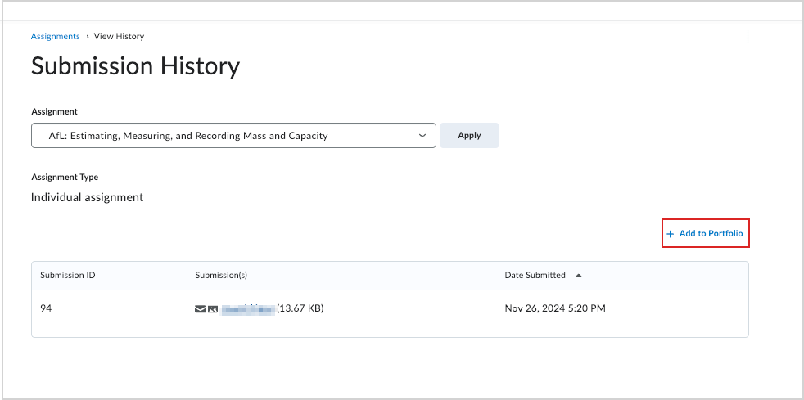
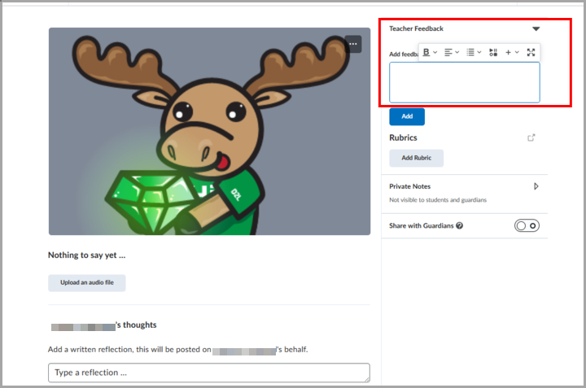
Portfolio
Learners can now import submitted assignments into their Portfolio, allowing them to reflect on and enhance their learning records in Brightspace.
Users can now also find evidence more easily in the Portfolio tool with improved filtering and sorting options.
The (WYSIWYG) text editor for Portfolio feedback, to enhance instructor experience with rich text and media tools.
Click + Add to Portfolio to add a submitted assignment to a portfolio
Use Case
Learners can independently build their learning portfolio by selecting meaningful assignments for reflection and showcase, eliminating dependency on instructor intervention. This supports learner ownership of their learning documentation while reducing administrative burden for instructors.
The Feedback editor now includes the rich text editing and formatting options
Availability: Brightspace, Live, Global
Notes:
Portfolio – Find evidence easily with improved searchability – Jan 2025
Portfolio – Import a submitted assignment as a learner – Jan 2025
Portfolio – WYSIWYG text editor for Portfolio Feedback – June 2025

Slide 17

Creator+
Deliver Courses That Captivate

Slide 18
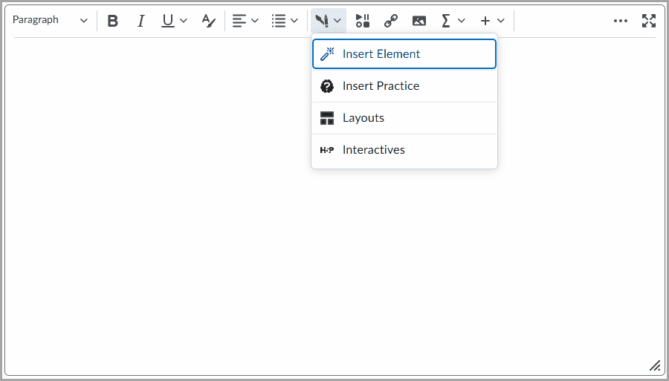
New Authoring Tools Menu
A new Authoring Tools menu has been added to the Brightspace Editor, replacing the previous Other Insert Options menu for Creator+ users. Insert Elements, Practices, Layouts, and H5P Interactives now appear together in this dedicated menu, making them easier to find and use. This update improves tool visibility, organization, and overall authoring efficiency for Creator+ customers.
Use Case
Educators and course creators using Creator+ can now access all their authoring tools in one place, reducing time spent navigating menus and improving content creation workflows. This streamlined experience makes it easier to build engaging learning materials with fewer clicks and less confusion.
Use the new dedicated Authoring Tools menu in Brightspace Editor to access the Creator+ tools and H5P Interactives
Availability: Creator+, Live, Global
Notes:
Creator+/H5P – New Authoring Tools Menu in Brightspace Editor – Jan 2025

Slide 19
Media Library
A fresh new look for Media Library that allows for storing, updating and reusing all files, not just video and audio.
Support for more file types, including SCORM objects, Office documents, images and PDF files. Add content in the Media Library and seamlessly import it into course structures.
Use Case
Improves workflow efficiencies, streamlines content management and enhances content reusability for Educators and Creators.
The new Media Library experience
Availability: Creator+, Live, Global
Notes:
Media Library – New User Interface for Media Library – April 2025

Slide 20
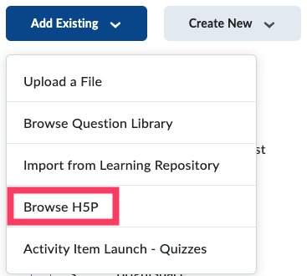
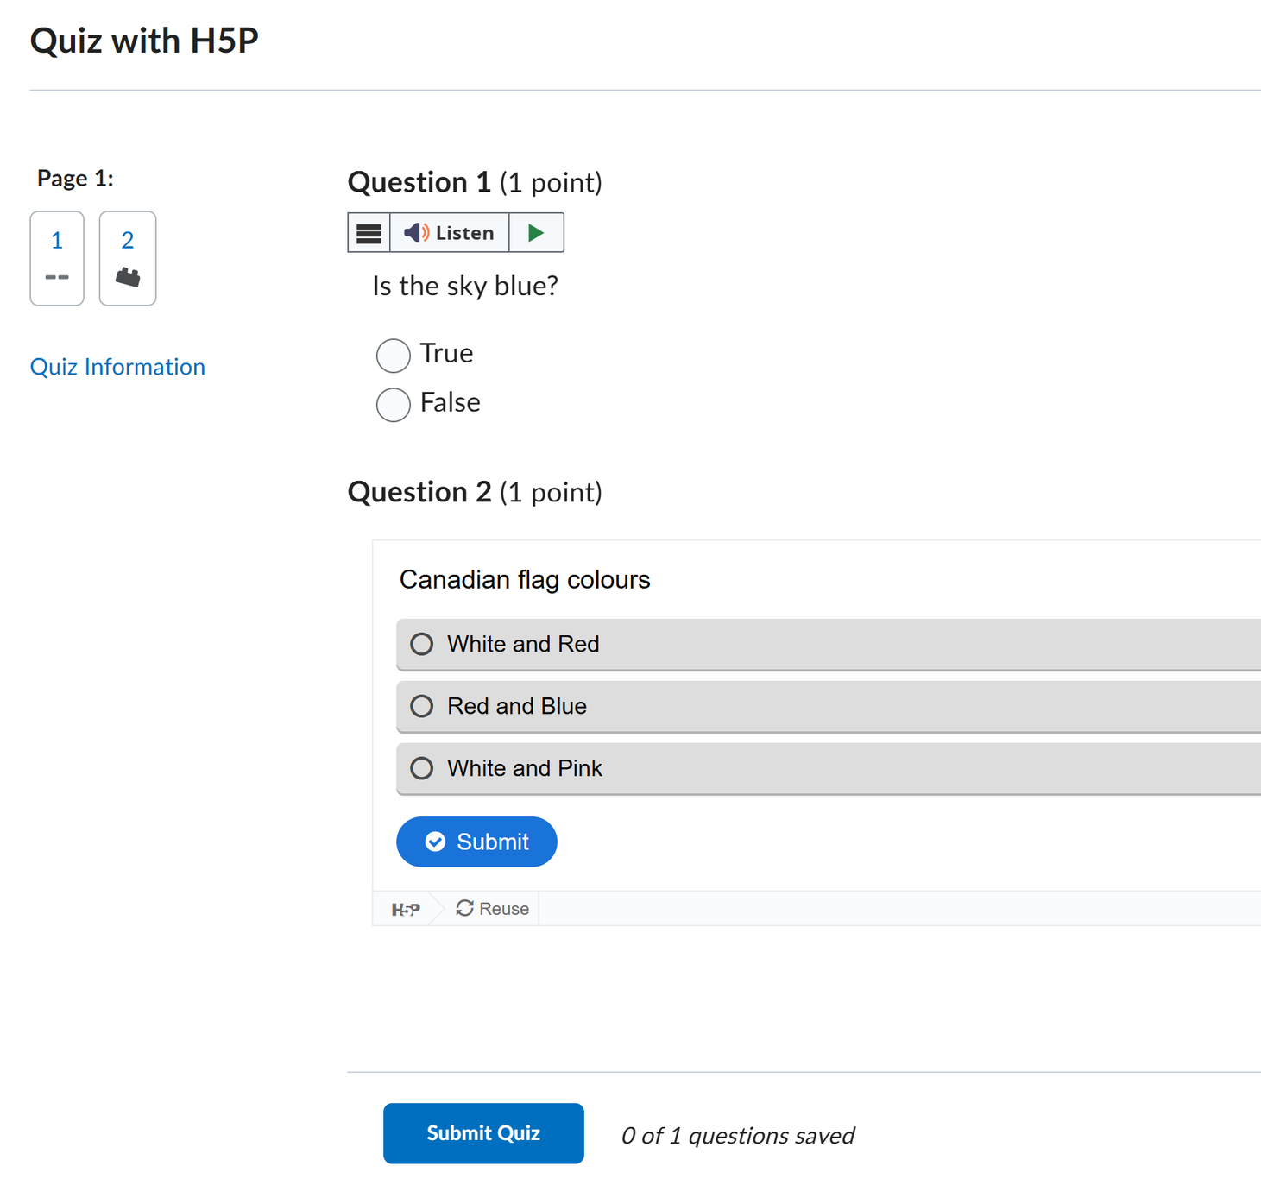
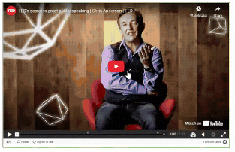
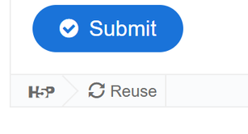
H5P Interactives in Quizzes
Existing H5P questions can be imported into Quizzes, allowing them to be used in formative assessment.
Beta in July 2025 for clients with the All-New Creator+ with H5P package.
Use Case
Simplify the quiz creation workflow and improve the variety of question types to increase engagement.
An example of an H5P interactive in a Quiz
Availability: Creator+, Beta, Global
Notes:
See https://h5p.org/roadmap for details

Slide 21

D2L Lumi
Elevate Learning, Empower Success

Slide 22
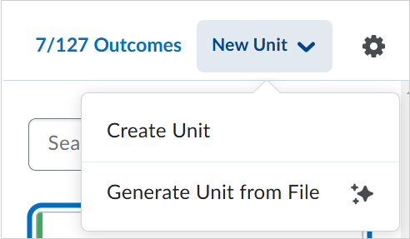
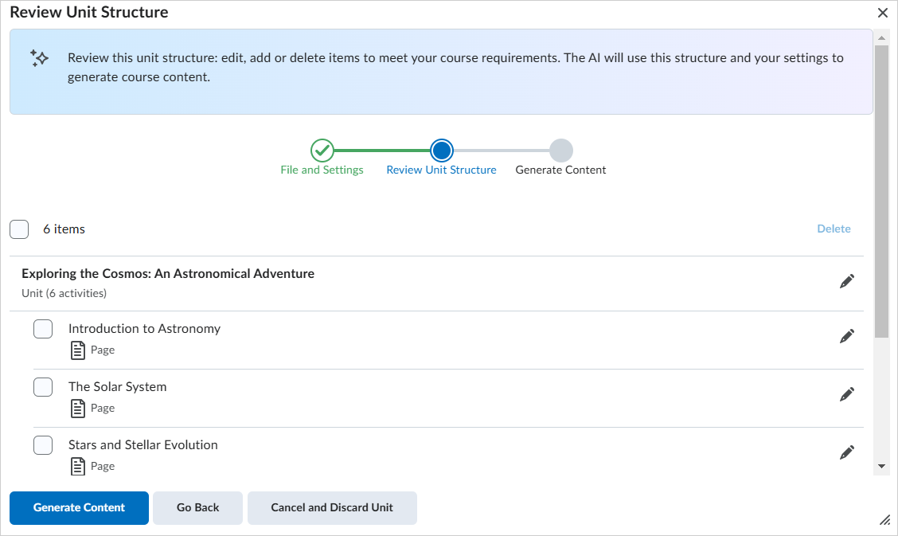
Generate Content From Files
Take the knowledge locked up in offline documents or presentations and turn them into real learning materials.
Lumi can read your Word or PowerPoint file and produce a Brightspace module filled with content pages, broken out by topic or concept.
All content must be reviewed by instructors before learners can access it, keeping humans in control and in the loop.
Use Case
Accelerates content creation by converting common file types into engaging and navigable Brightspace content, improving workflow efficiencies for Instructors and Educators.
Simplifies the process for centralized course creation teams to import existing content into Brightspace.
Create engaging learning materials from external files with D2L Lumi Content
Availability: Lumi, Live, Global
Notes:
D2L Lumi Pro – Create AI-generated learning materials from external files – April 2025

Slide 23
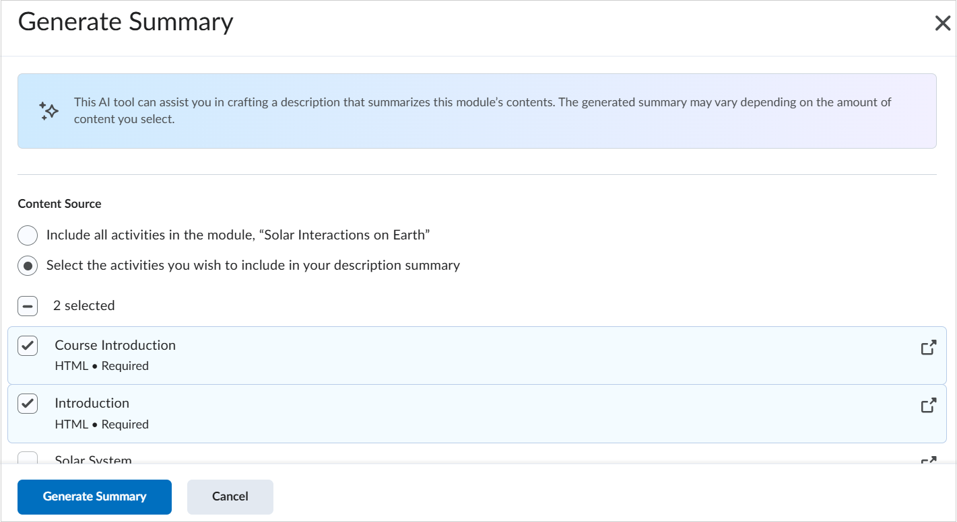
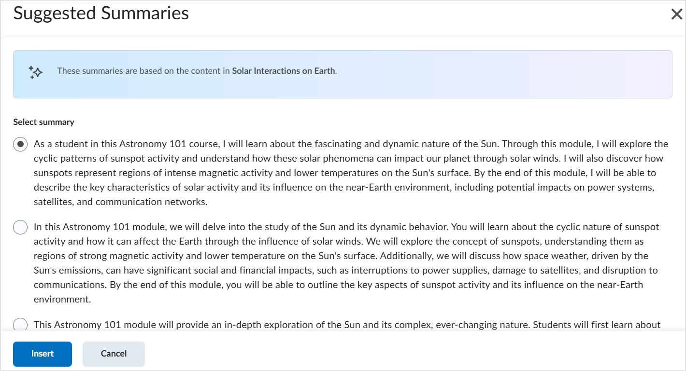
Content Summaries
Help learners prepare and engage quickly with summary descriptions.
Lumi can read your upcoming lesson, module, or weekly unit and produce a text summary to help everyone get ready to learn. All content is reviewed by the instructor before learners can access it, ensuring accurate information.
Use Case
Ensures learners are prepared, engaged and ready for upcoming material with AI-generated summaries based on the inner contents of a module.
Instructors can quickly and easily generate summaries from existing content, improving workflow efficiencies.
Generating new summaries with D2L Lumi Pro
Availability: Lumi, Live, Global
Notes:
D2L Lumi Pro – Create engaging AI-generated content module summaries – April 2025

Slide 24
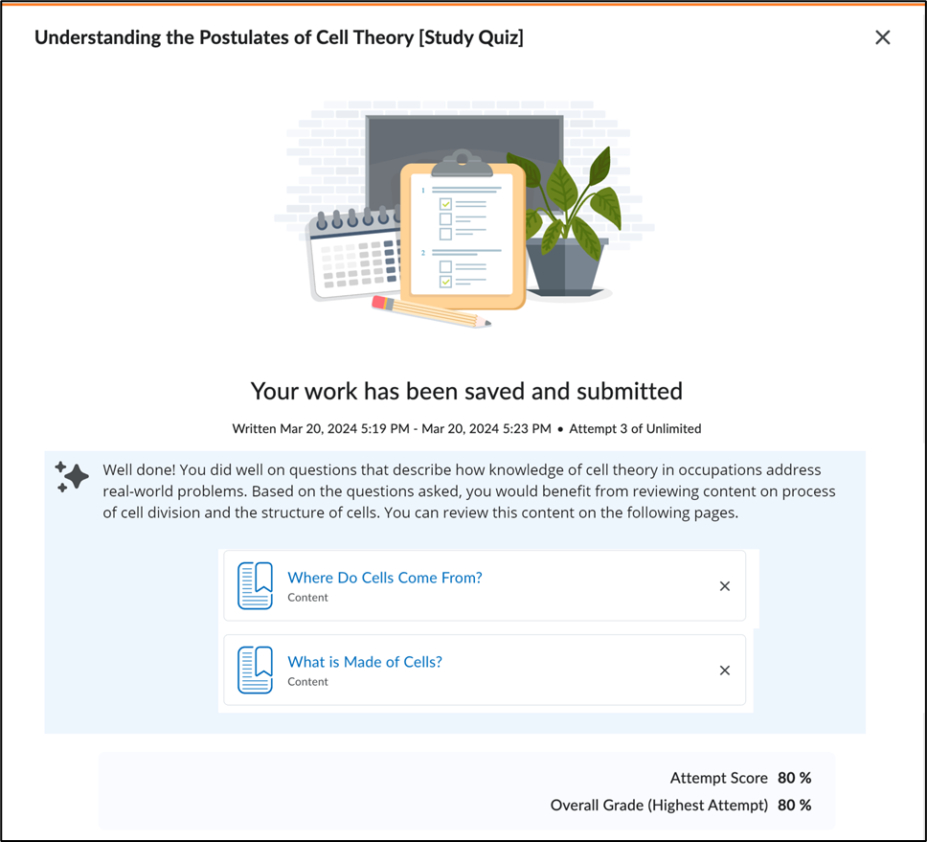
Study Support
Help learners in the moment with intelligent study support.
D2L Lumi now recommends course content at the close of each quiz - congratulating learners on the topics they've mastered and taking them straight to the material they need to review in order to master the rest.
Use Case
Scale, support, and assist every learner as they study with a practice quiz with personalized content suggestions.
Enhance learner preparedness by identify knowledge gaps and guide their study efforts, improving achievement.
D2L Lumi Study Support from the Learner view
Availability: Lumi, Live, Global
Notes:
D2L Lumi Pro – Recommend study support materials based on Quizzes – April 2025

Slide 25
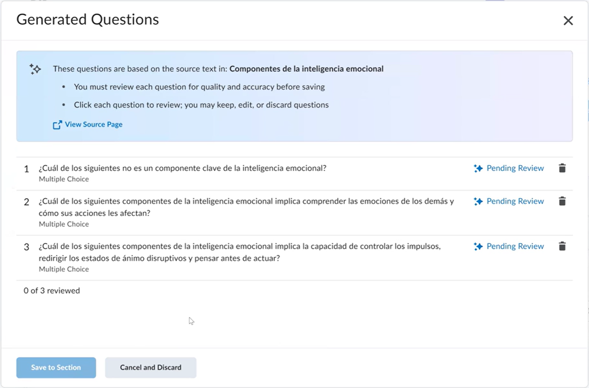
Multilingual Content
Generate content for the following languages: French, Spanish, Portuguese, and Dutch.
New language support is vetted with real learners, instructors, and authors before release, so you can go multilingual with confidence.
Use Case
Enables Educators and Creators to reach more learners with multilingual support and improve workflow efficiencies around the world.
D2L Lumi in Spanish
Availability: Creator+/Lumi, Live, Global
Notes:
D2L Lumi Pro and D2L Lumi for Creator+ – Language support for French, Spanish, Portuguese, and Dutch – April 2025

Slide 26
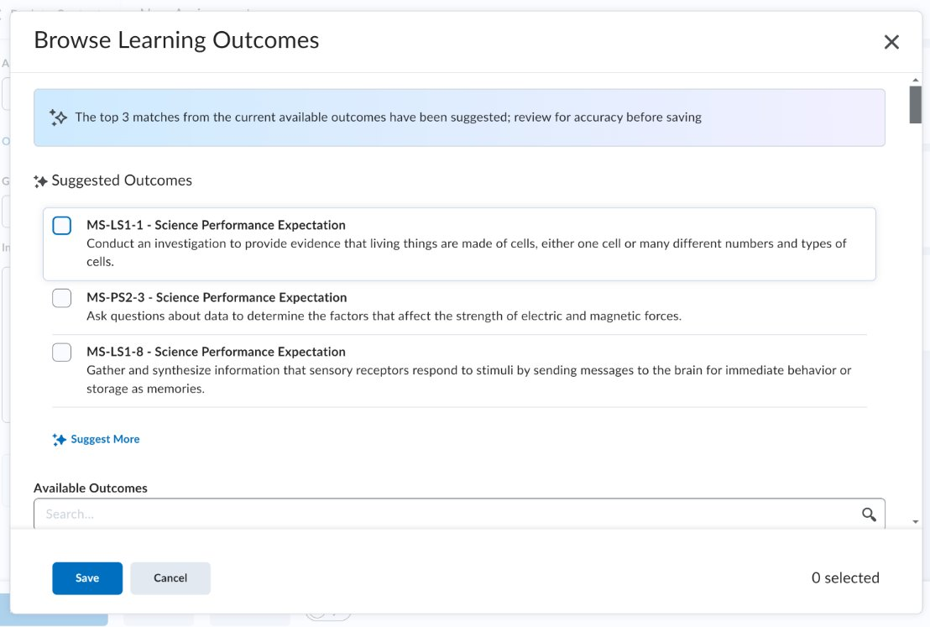
Suggested Outcomes for Content & Discussions
Adopt outcomes across your whole teaching and learning suite, faster than ever.
Automatically suggest outcome alignments for your assignments, pages and discussions.
Use Case
Reduce effort when aligning course material to learning outcomes for more activities in Brightspace, increasing the velocity of assignments, content and discussion creation.
D2L Lumi Outcome screenshot
Availability: Lumi, Live, Global
Notes:
Globally available as of April 2025

Slide 27

Performance+
Link Data to Decisions

Slide 28
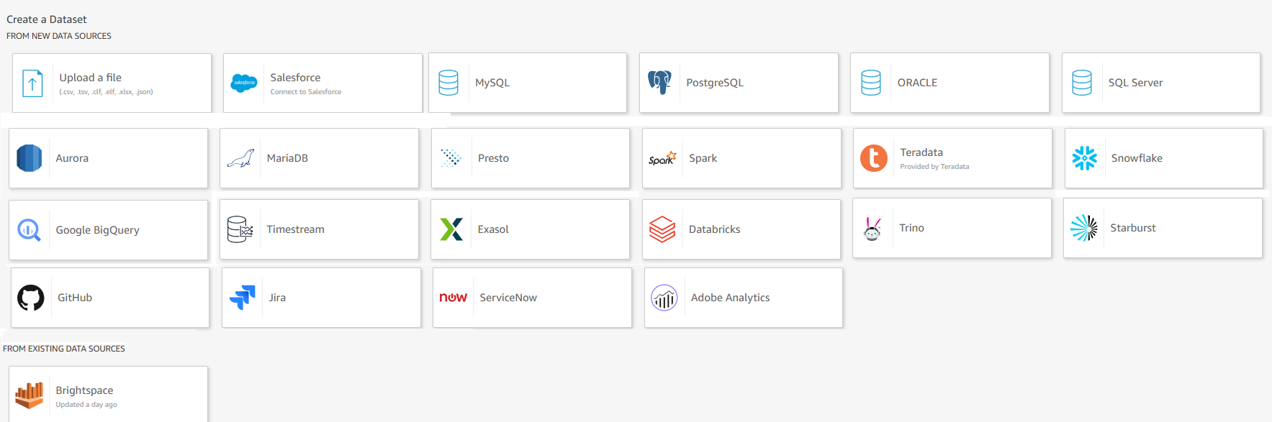
Analytics Builder – External Data Support
Pull in external, non-Brightspace data from 22 external sources–such as your SIS, CRM, HRIS–into Analytics Builder.
Use Case
Build more comprehensive learning reports to access all learner data in one spot.
Examples of external data sources that can be connected to Analytics Builder
Availability: Performance+, Live, Global
Notes:
Analytics Builder – Support for additional data sources – April 2025

Slide 29

D2L Link
Simplify System Integration

Slide 30
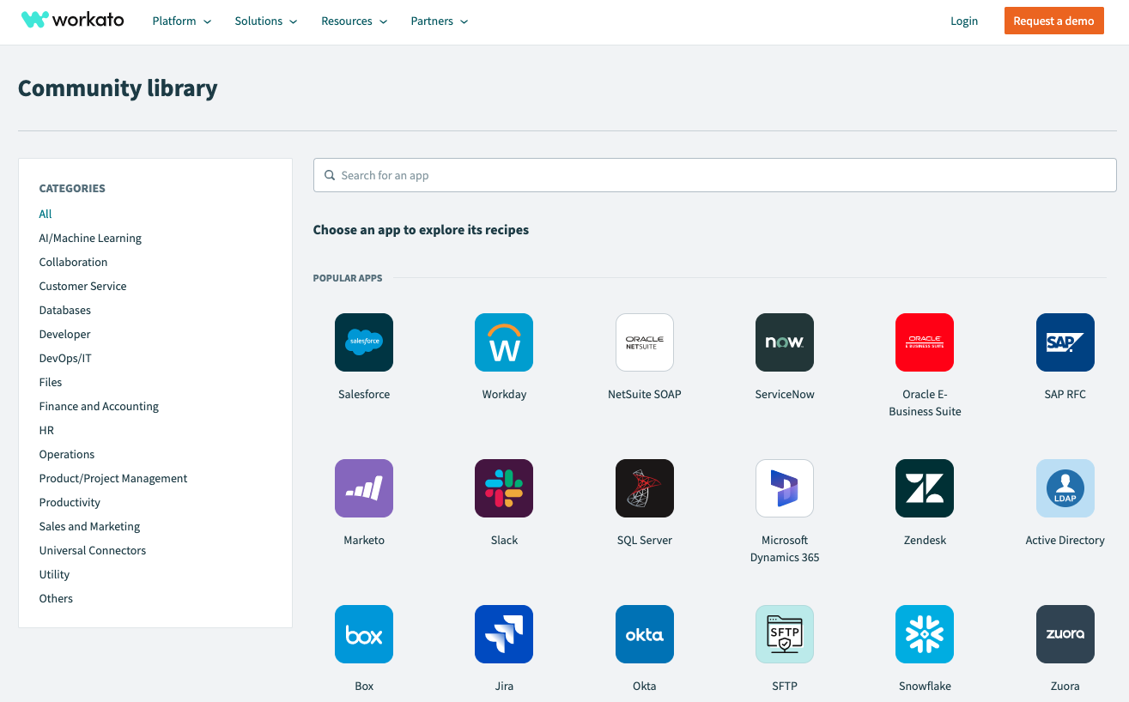
D2L Link – Brightspace Connector
Build no-code integrations with the D2L Brightspace Connector, now available in the Workato Community Library.
This provides the ability to create and update the following:
Users, Org Units, Enrollments, and Custom Actions
Use Case
Customers with a licensed Workato workspace can use the D2L Brightspace Connector in the Workato Community Library to build low and no-code Brightspace automation and integrations.
The Workato Community Library
Availability: Link, Live, Global
Notes:
D2L Link – D2L Brightspace Connector is now available in Workato Community Library – March 2025

Slide 31
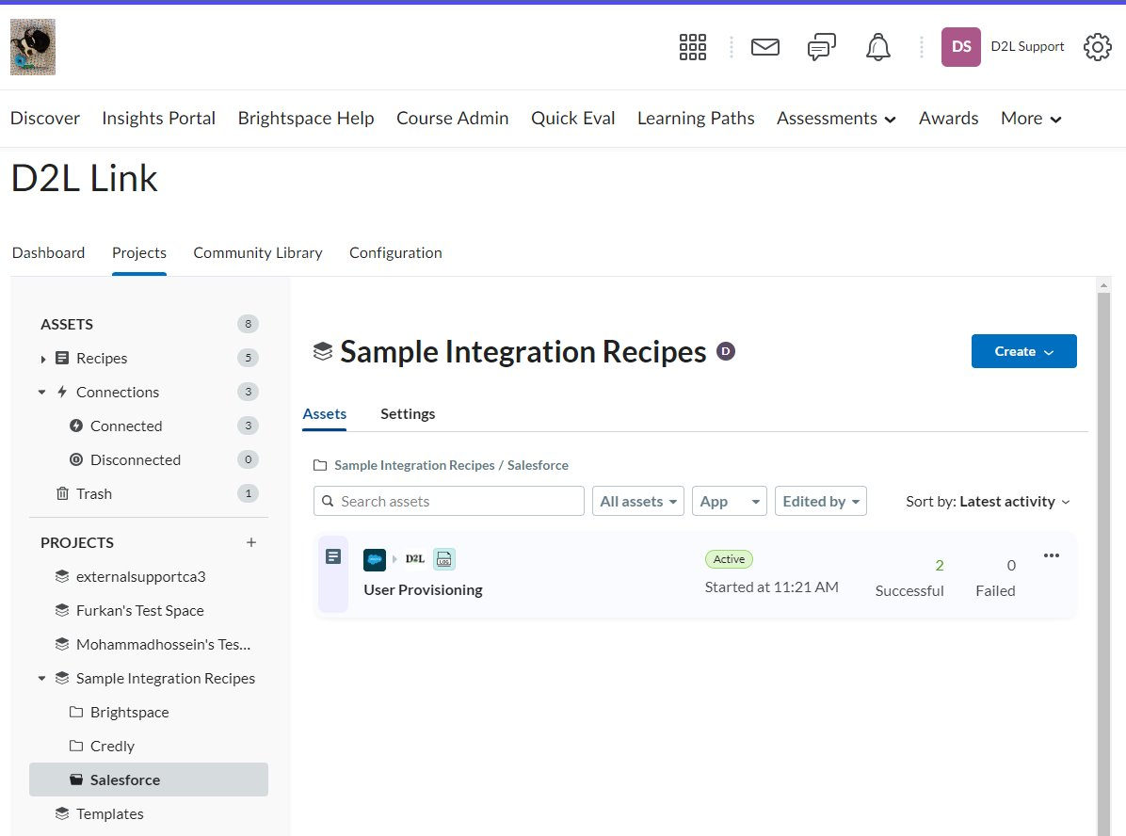
Grade Automation
Automate grade workflows faster than ever. New grade APIs let you trigger a Link recipe whenever grades are updated or released, and process those grades singly or in bulk with our no-code automation approach.
Use Case
This supports critical business workflows related to grade automations and data integrations between Brightspace, and other external systems used by our customers.​
A sample screen of D2L Link projects and recipes
Availability: Link, Live, Global
Notes:
D2L Link Brightspace Connector is improved to use new APIs for retrieving bulk grade – April 2025

Slide 32
THANK YOU

